Slide 1

Hello.

Slide 2

Lets’ have some coffee?

Slide 3

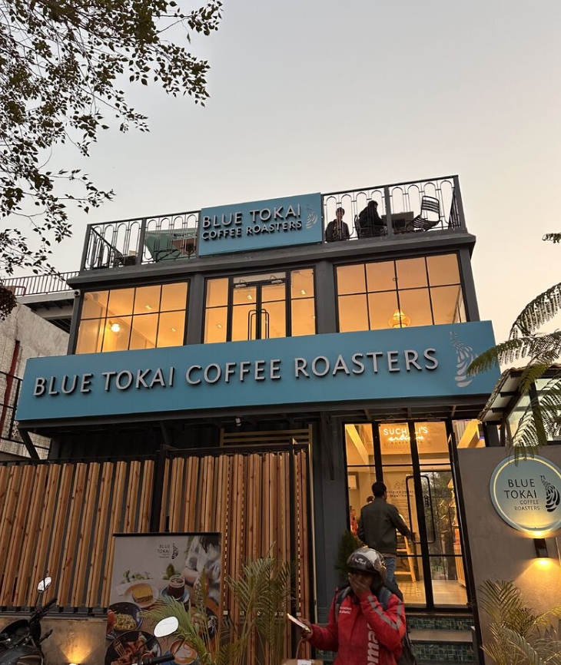
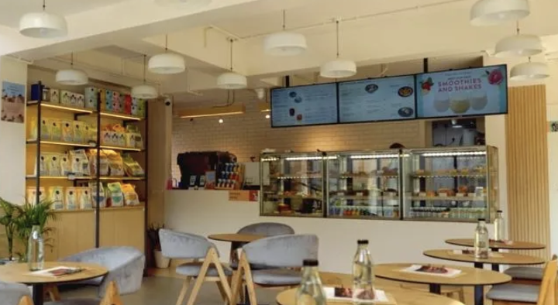
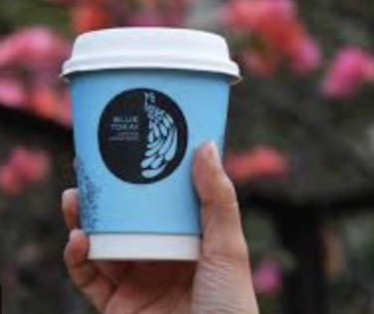
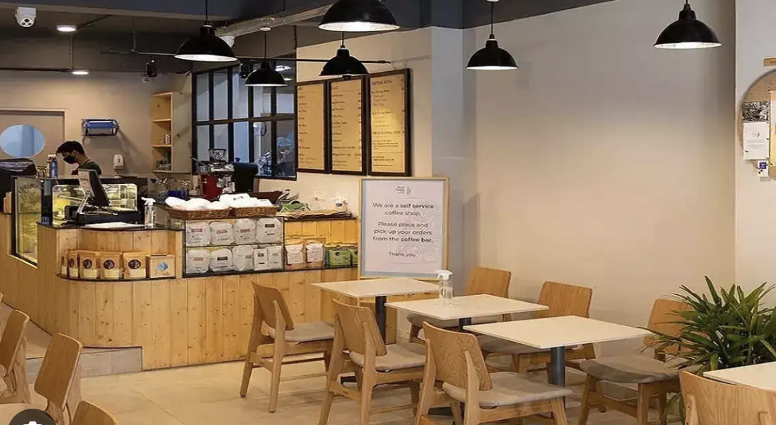
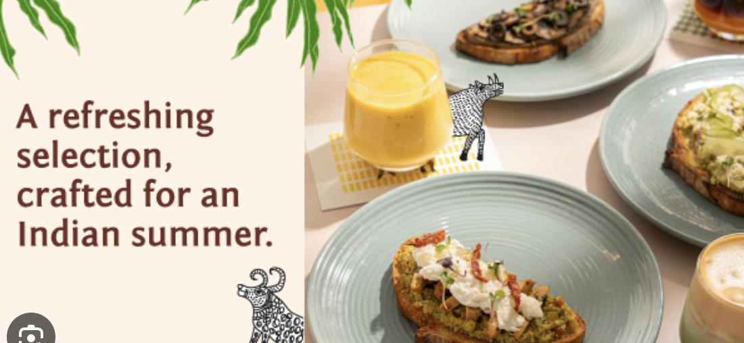
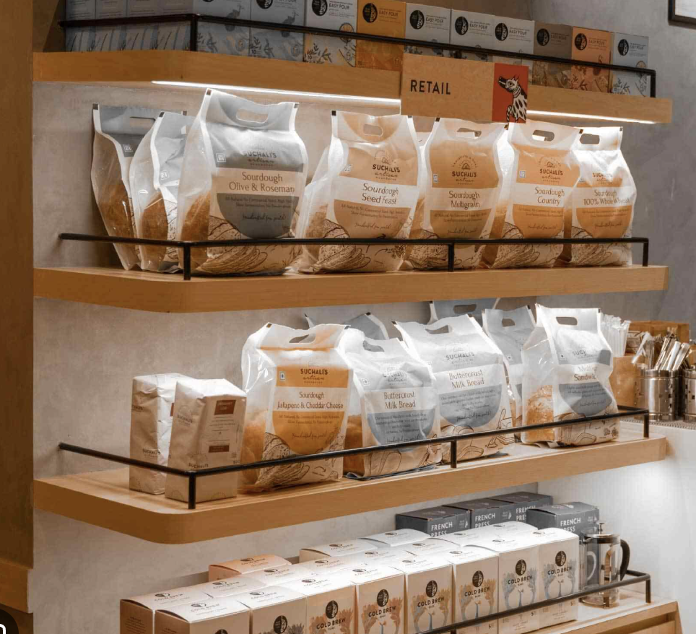
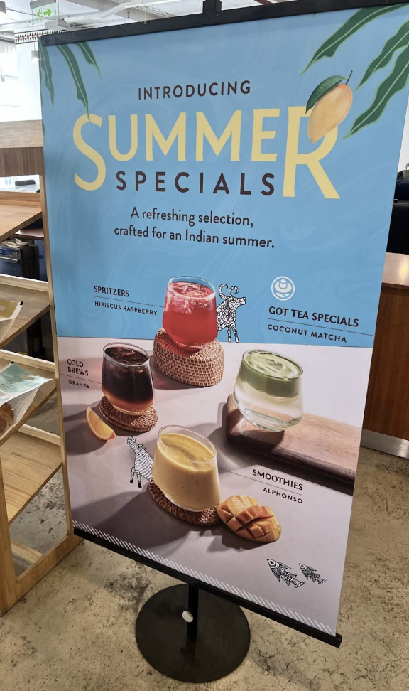

Slide 4

What is Marketing

Slide 5
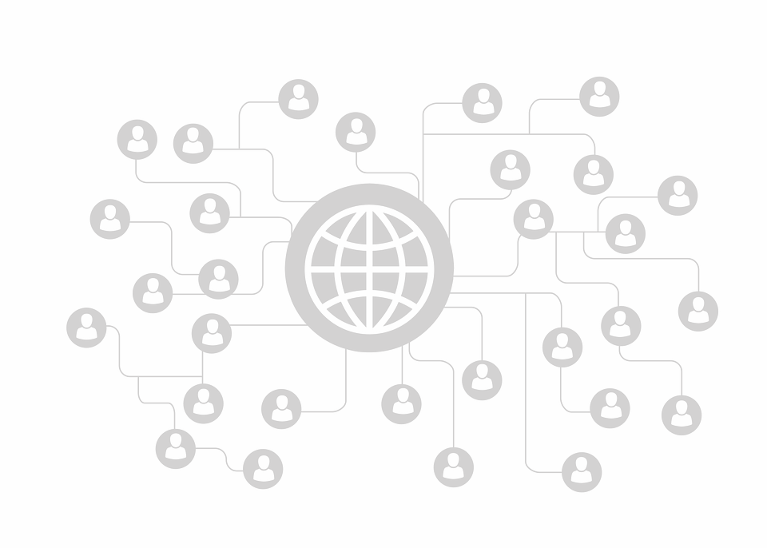

“An organizational function and a set of processes for creating, communicating and delivering value to customers and for managing customer relationships in ways that benefit the organization and its stakeholders…”
Source – A Framework for Marketing Management by Philip Kotler & Kevin Keller
Notes:
Source – A framework for Marketing Management by Philip Kotler & Kevin Keller
Other Key Definitions of Marketing – Below are the various definitions presented for marketing. This also gives you an indication of evolution of marketing.
Early Sales Orientation (1900s–1930s) - Marketing is the art of selling products
Customer Needs Orientation (1950s–1970s) Peter Drucker (1954):The aim of marketing is to know and understand the customer so well that the product. Kotler’s classic (1967) - Marketing is the human activity directed at satisfying needs and wants through exchange processes
3. Value Creation & Relationship Era (1980s–2000s) - American Marketing Association (AMA, 1985) - Marketing is the process of planning and executing the conception, pricing, promotion, and distribution of ideas, goods, and services to create exchanges that satisfy individual and organizational goals.
Kotler & Armstrong (1991) -Marketing is the process by which companies create value for customers and build strong customer relationships in order to capture value from customers in return.
4. Modern Societal Orientation (2007–present) - AMA (2007, current official definition)- Marketing is the activity, set of institutions, and processes for creating, communicating, delivering, and exchanging offerings that have value for customers, clients, partners, and society at large.
Kotler (2010s)- Marketing is the science and art of exploring, creating, and delivering value to satisfy the needs of a target market at a profit.
5. Contemporary Expansions- Philip Kotler (Marketing 4.0 / 5.0) - Marketing today must blend human-centricity with technology, focusing on connectivity, personalization, and purpose.
Seth Godin (modern thinker):
Marketing is the act of making change happen. It’s about spreading ideas and making things better.

Slide 6
Additional Notes
Source – A framework for Marketing Management by Philip Kotler & Kevin Keller
Other Key Definitions of Marketing – Below are the various definitions presented for marketing. This also gives you an indication of evolution of marketing.
Early Sales Orientation (1900s–1930s) - Marketing is the art of selling products
Customer Needs Orientation (1950s–1970s) Peter Drucker (1954):The aim of marketing is to know and understand the customer so well that the product. Kotler’s classic (1967) - Marketing is the human activity directed at satisfying needs and wants through exchange processes
3. Value Creation & Relationship Era (1980s–2000s) - American Marketing Association (AMA, 1985) - Marketing is the process of planning and executing the conception, pricing, promotion, and distribution of ideas, goods, and services to create exchanges that satisfy individual and organizational goals.
Kotler & Armstrong (1991) -Marketing is the process by which companies create value for customers and build strong customer relationships in order to capture value from customers in return.
4. Modern Societal Orientation (2007–present) - AMA (2007, current official definition)- Marketing is the activity, set of institutions, and processes for creating, communicating, delivering, and exchanging offerings that have value for customers, clients, partners, and society at large.
Kotler (2010s)- Marketing is the science and art of exploring, creating, and delivering value to satisfy the needs of a target market at a profit.
5. Contemporary Expansions- Philip Kotler (Marketing 4.0 / 5.0) - Marketing today must blend human-centricity with technology, focusing on connectivity, personalization, and purpose.
Seth Godin (modern thinker):
Marketing is the act of making change happen. It’s about spreading ideas and making things better.

Slide 7
“An organizational function and a set of processes for creating, communicating and delivering value to customers and for managing customer relationships in ways that benefit the organization and its stakeholders…”
Source – A Framework for Marketing Management by Philip Kotler & Kevin Keller
Notes:
Marketing is about creating –
Creating Products & Services
Innovation: Developing something new (e.g., Tesla creating EVs that redefined the automobile).
Differentiation: Adding unique features to stand out (e.g., Epigamia creating Greek yogurt as a new dairy sub-category in India).
Customization: Tailoring to specific needs (e.g., Nike By You sneaker personalization).
2. Creating Experiences
Not just tangible goods — intangible value. Example: Starbucks doesn’t just sell coffee, it creates a “third place” experience between home and work.
OR Disney creates worlds of imagination — the value lies as much in the experience as the product.
3. Creating Markets Sometimes marketing literally creates new categories:
Airbnb: Created the home-stay market.
Red Bull: Created the “energy drink” category.
Colgate in rural India: Created awareness of modern oral hygiene where none existed.

Slide 8


Creating Value
Goods/Properties
Services/Platforms
Personal Brands
Physical/Tangible goods – CPG, Electronics, Fashion, Toys, Furniture, Books, Homes, Word/Excel etc.
Airlines, Retail, Banks, Rentals, Repairs, Salons, Lawyers, Architects, Consulting, Education, Uber, Amazon, SAAS/SAP, etc.
Politicians, Celebrities, Influencers, Consultants, Advisors, Artists
Experiences/Places/Events
Organizations
Concerts, Parks, Trade shows, Sporting events, Museum, Cities, States, Tourism
Corporations, NGO/Non-Profit, Universities, Museum, Government, etc.

Slide 9

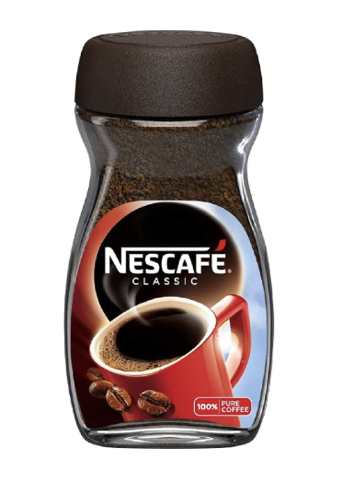
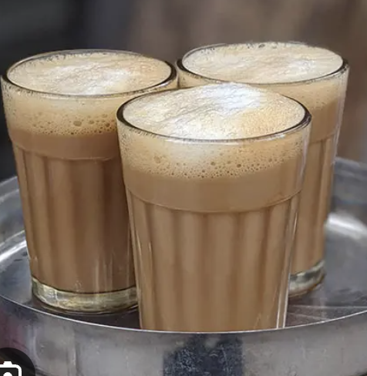
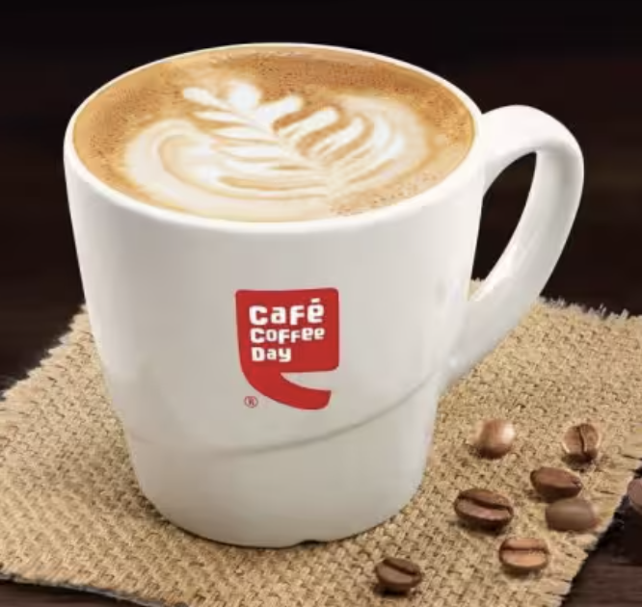
Creating Value
Notes:
Blue Tokai has created Value by providing premium crafted coffee which focus on taste and experience. It differentiates itself from from the coffee you at home directly competes with the likes of Café Coffee day and Starbucks with focus on the various premium blend of coffee being the core.

Slide 10
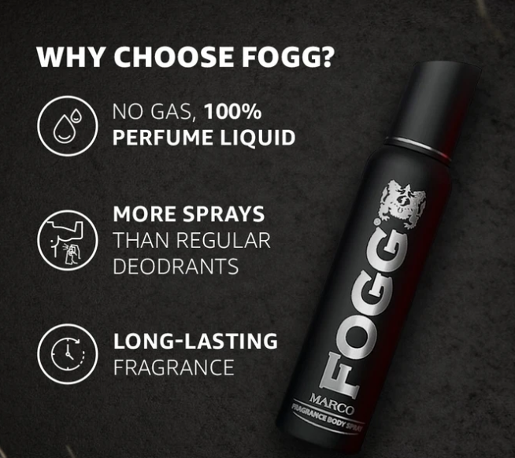
Creating Value
Notes:
In a market of fragrances, which was solely focused on sexuality and man getting woman, driven by brands like Axe, set wet, etc. Fogg arrived with a unique product that focused on long lasting fragrance and the unique reason to believe that it was not gas but a 100% perfume liquid.

Slide 11
Additional Notes
Marketing is about creating –
Creating Products & Services
  Innovation: Developing something new (e.g., Tesla creating EVs that redefined the automobile).
  Differentiation: Adding unique features to stand out (e.g., Epigamia creating Greek yogurt as a new dairy sub-category in India).
  Customization: Tailoring to specific needs (e.g., Nike By You sneaker personalization).
2. Creating Experiences
Not just tangible goods — intangible value. Example: Starbucks doesn’t just sell coffee, it creates a “third place” experience between home and work.
OR Disney creates worlds of imagination — the value lies as much in the experience as the product.
3. Creating Markets Sometimes marketing literally creates new categories:
  Airbnb: Created the home-stay market.
  Red Bull: Created the “energy drink” category.
  Colgate in rural India: Created awareness of modern oral hygiene where none existed.

Slide 12
“An organizational function and a set of processes for creating, communicating and delivering value to customers and for managing customer relationships in ways that benefit the organization and its stakeholders…”
Source – A Framework for Marketing Management by Philip Kotler & Kevin Keller
Notes:
Informing - At the most basic level, communication tells customers that a product exists and what it does. Example: A new food brand communicating its ingredients, nutrition, and usage.
2. Persuading- Beyond facts, communication shapes preferences and choices. Example: Apple persuades by dramatizing simplicity and elegance in its ads. Example: Nike persuades through emotional storytelling (“Just Do It”).
3. Building Relationships - Communication is also about conversation and connection, not one-way messaging. Example: Zomato’s quirky push notifications and tweets keep the brand top-of-mind and likable. Example: Wendy’s (US) built a following by bantering with customers on Twitter.
4. Creating Meaning & Positioning- Communication frames how people perceive the value. Example: Volvo doesn’t just say “cars” — it communicates “safety.” Example: Coca-Cola communicates “happiness and togetherness,” not just soda.
5. Channels of Communication -Communication today is omnichannel:
Traditional: TV, print, outdoor.
Digital: Social media, email, influencers, SEO.
Experiential: Events, activations, in-store demos.
6. Feedback & Dialogue- Modern marketing = listening as much as talking.: Lego Ideas platform lets fans co-create sets → communication becomes two-way value. Example: Spotify Wrapped → communicates you are unique, while gathering data for personalization.

Slide 13
Communicating Value
Advertising
Engagement
Driving Awareness, Preference & Relevance via Media – TV, Radio, Outdoors, Print, Social Media, Direct Marketing, etc.
Driving content to drive top of mind via Social media, PR, Events
Performance
Driving Conversion through Promotions, Ads, Merchandising, Brokers/Promoters, Events etc.

Slide 14
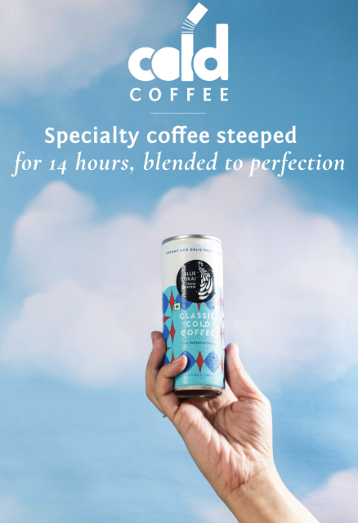
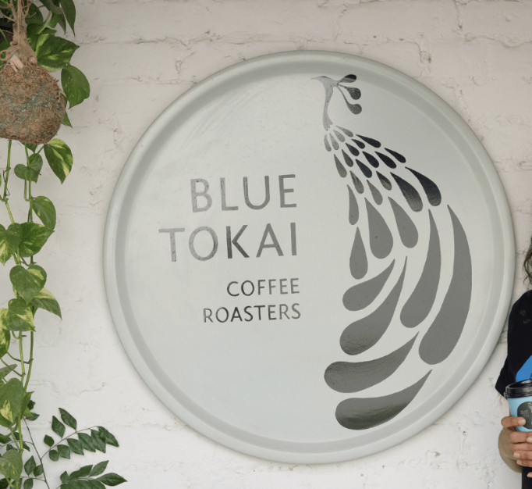
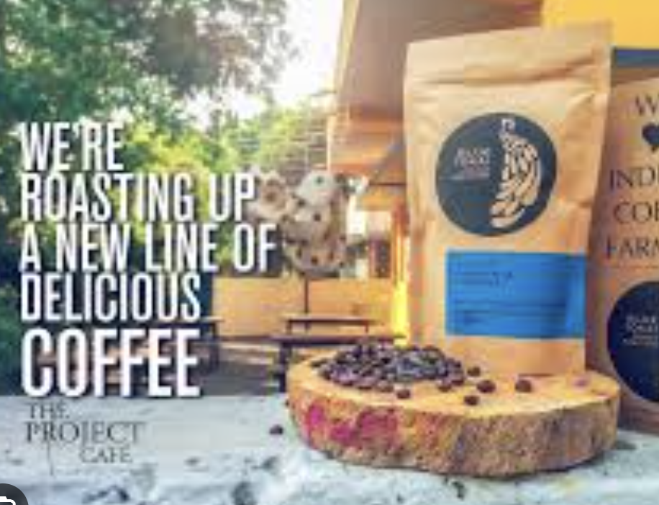
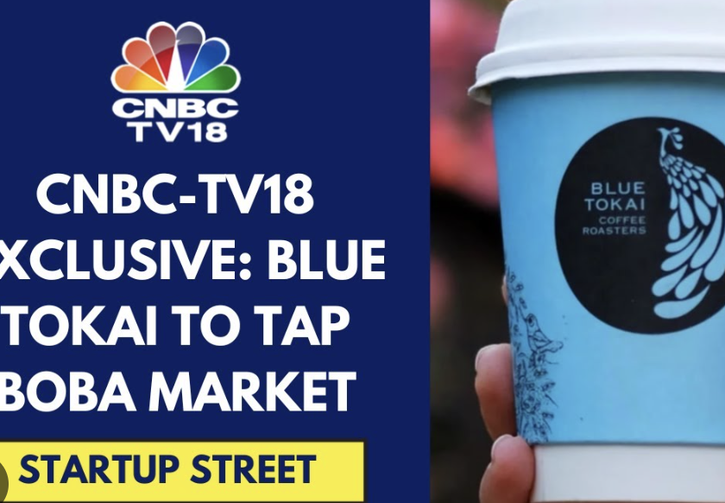
Communicating Value

Slide 15
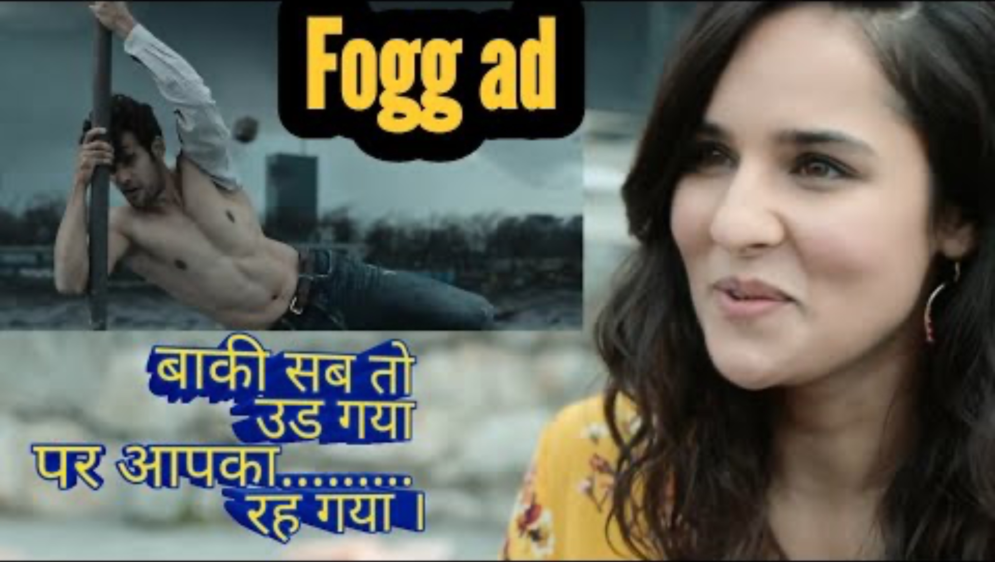
Communicating Value

Slide 16
Additional Notes
Informing - At the most basic level, communication tells customers that a product exists and what it does. Example: A new food brand communicating its ingredients, nutrition, and usage.
2. Persuading- Beyond facts, communication shapes preferences and choices. Example: Apple persuades by dramatizing simplicity and elegance in its ads. Example: Nike persuades through emotional storytelling (“Just Do It”).
3. Building Relationships - Communication is also about conversation and connection, not one-way messaging. Example: Zomato’s quirky push notifications and tweets keep the brand top-of-mind and likable. Example: Wendy’s (US) built a following by bantering with customers on Twitter.
4. Creating Meaning & Positioning- Communication frames how people perceive the value. Example: Volvo doesn’t just say “cars” — it communicates “safety.” Example: Coca-Cola communicates “happiness and togetherness,” not just soda.
5. Channels of Communication -Communication today is omnichannel:
  Traditional: TV, print, outdoor.
  Digital: Social media, email, influencers, SEO.
  Experiential: Events, activations, in-store demos.
6. Feedback & Dialogue- Modern marketing = listening as much as talking.: Lego Ideas platform lets fans co-create sets → communication becomes two-way value. Example: Spotify Wrapped → communicates you are unique, while gathering data for personalization.

Slide 17
“An organizational function and a set of processes for creating, communicating and delivering value to customers and for managing customer relationships in ways that benefit the organization and its stakeholders…”
Source – A Framework for Marketing Management by Philip Kotler & Kevin Keller
Notes:
Note - ( this will be elaborated in future sessions)
1. Distribution & Access - Value has no meaning if customers can’t access it. Example: Amul ensures its dairy products are available in the tiniest kirana shops across India . .Example: Amazon Prime’s next-day delivery = access + convenience as a value in itself.
2. Channel Choice - Choosing the right channel is part of delivering.
FMCG: kirana stores, supermarkets, modern trade.
Premium spirits: high-end bars, luxury retail, duty-free shops.
Digital-first brands: D2C websites, marketplaces, quick commerce.
The channel itself signals and shapes the value (a Rolex sold in a roadside stall loses its premium meaning).
3. Customer Experience - Delivery isn’t just physical, it’s also experiential. Example: Apple Stores deliver value by making you experience the brand — not just buy a gadget. Example: Zappos delivers with legendary customer service (free returns, 24/7 support).
4. Reliability & Consistency- Delivery is about living up to the promise communicated. Example: Domino’s “30 minutes or free” — delivery became the value. Example: Uber delivers by ensuring a ride is always a tap away → reliability creates trust.
5. Personalization & Last-Mile Delight - Modern delivery goes beyond logistics to tailored experiences. Example: Netflix delivers entertainment curated to your taste via algorithms. Example: D2C beauty brands like Nykaa deliver value by adding samples or handwritten notes → emotional delight.

Slide 18
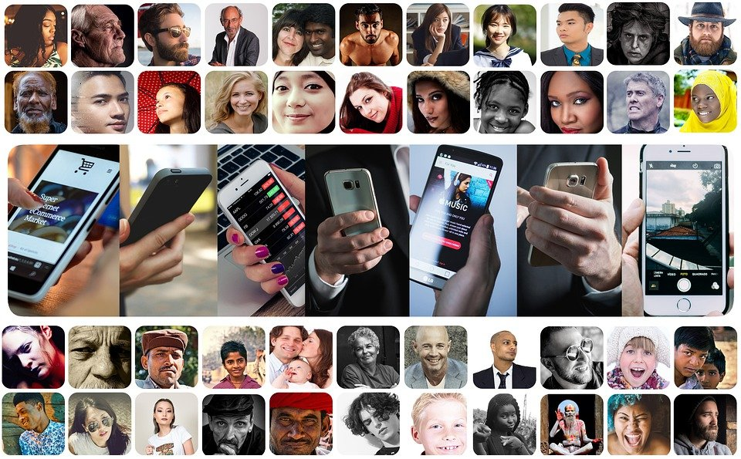
Delivering Value
How does Blue Tokai Deliver Value

Slide 19
Delivering Value
Store in High Street
Stores in Malls
Kiosks at corporate parks/Malls/Airports
D2C
Marketplaces
Food Delivery
Notes:
Physical Stores – Owned/Distributed, Middle-Men – Wholesalers, Brokers, Website/App, Platforms, Malls

Slide 20
Additional Notes
Note - ( this will be elaborated in future sessions)
1. Distribution & Access - Value has no meaning if customers can’t access it. Example: Amul ensures its dairy products are available in the tiniest kirana shops across India . .Example: Amazon Prime’s next-day delivery = access + convenience as a value in itself.
2. Channel Choice - Choosing the right channel is part of delivering.
  FMCG: kirana stores, supermarkets, modern trade.
  Premium spirits: high-end bars, luxury retail, duty-free shops.
  Digital-first brands: D2C websites, marketplaces, quick commerce.
  The channel itself signals and shapes the value (a Rolex sold in a roadside stall loses its premium meaning).
3. Customer Experience - Delivery isn’t just physical, it’s also experiential. Example: Apple Stores deliver value by making you experience the brand — not just buy a gadget. Example: Zappos delivers with legendary customer service (free returns, 24/7 support).
4. Reliability & Consistency- Delivery is about living up to the promise communicated. Example: Domino’s “30 minutes or free” — delivery became the value. Example: Uber delivers by ensuring a ride is always a tap away → reliability creates trust.
5. Personalization & Last-Mile Delight - Modern delivery goes beyond logistics to tailored experiences. Example: Netflix delivers entertainment curated to your taste via algorithms. Example: D2C beauty brands like Nykaa deliver value by adding samples or handwritten notes → emotional delight.

Slide 21
“An organizational function and a set of processes for creating, communicating and delivering value to customers and for managing customer relationships in ways that benefit the organization and its stakeholders…”
Source – A Framework for Marketing Management by Philip Kotler & Kevin Keller
Notes:
From Transactions → Relationships
Earlier marketing: focus on one-time sales.
Modern marketing: lifetime value of a customer.
Example: Amazon doesn’t just sell books anymore — it builds Prime membership loyalty that keeps customers in their ecosystem.
2. Trust & Consistency
Relationships = trust built over time through reliable delivery of promises.
Example: Colgate has decades of trust because parents pass it down to children — consistency reinforces the relationship.
Example: HDFC Bank communicates “We understand your world” and backs it with service reliability.
3. Personalization & Relevance
Strong relationships require knowing the customer.
Example: Spotify Wrapped strengthens the emotional bond by showing each listener a personalized story.
Example: Starbucks rewards app: personalized offers based on your past purchases.
4. Two-Way Dialogue
Relationships are not one-sided messaging, but conversations.
Example: Zomato engages in witty back-and-forth on Twitter → customers feel heard and valued.
Example: LEGO Ideas platform lets fans co-create new sets → making the relationship participatory.
5. Customer Experience (CX) as Relationship Driver
Every touchpoint — from purchase to service — either strengthens or weakens the relationship.
Example: Apple’s Genius Bar isn’t just about fixing products, but nurturing a supportive brand experience.
Example: Zappos is famous for staying on customer support calls for hours to resolve issues → loyalty through care.
6. Loyalty & Advocacy
Strong relationships convert customers into repeat buyers and then into advocates.
Example: Harley-Davidson HOG clubs → customers not only ride bikes but also belong to a tribe.
Example: Amul cooperative → relationship with farmers and consumers → mutual loyalty.
7. Technology & CRM
Managing relationships at scale = Customer Relationship Management (CRM) systems, AI personalization, loyalty programs.
Example: Amazon’s recommendation engine is essentially relationship marketing powered by data.
Example: Sephora’s Beauty Insider program → tiered benefits deepen customer loyalty.

Slide 22



Managing Customer Relationships
Driving funnel
Make them aware
Attract/Get them to know about your offering
Drive preference
Build relevance and liking
Convert
Get them to buy/Click to buy/Line up
Engage
Top of mind for offering
Retain
Loyalty/Buy again/More/Cross sell/Redressals
Notes:
A customer relationship develops progressively. At each stage, the customer has a different question in their mind, and therefore marketing has a different job to do. Good marketing recognizes where the customer is in the funnel and uses the right intervention for that stage.
The funnel gets narrower because a much larger number of people will know about a brand than will eventually buy it. If 10 million people are aware of a brand, perhaps 3 million seriously consider it, 1 million try it, and a smaller number become repeat customers. One of marketing's jobs is therefore to reduce leakage as consumers move down the funnel.
1. Make Them Aware — “Do I know you?”
The first task of marketing is simply to enter the consumer's mental universe.
A consumer cannot consider or buy a brand that they do not know exists. Awareness is therefore about creating mental availability — ensuring that the brand comes to mind when the relevant category or need arises.
For example, if someone thinks, “I need food delivered tonight,” which brands immediately come to mind? If Zomato and Swiggy are the first two names recalled, both brands have achieved strong mental availability.
Awareness can come through advertising, social media, influencers, PR, sponsorships, word of mouth, retail visibility, packaging, search, etc.
There are different strengths of awareness:
Recognition: “I've heard of this brand.”
Recall: “I can remember this brand without being prompted.”
Top-of-mind: “This is the first brand I think of.”
The marketer's challenge is not simply to create maximum awareness. It is to create awareness among the right audience and in the right buying context.
Useful classroom question:
“If I say online food delivery, which brand comes to mind first? If I say toothpaste? Luxury smartphone? Why?”
This demonstrates that brands compete for a place in memory long before they compete at the point of purchase.
. Drive Preference — “Why should I choose you?”
Awareness gets you into the consideration set. It does not automatically get you chosen.
Once consumers know a brand, marketing has to create relevance and preference.
The consumer is effectively asking:
“There are five brands I could buy. Why this one?”
This is where positioning, differentiation and brand meaning become important.
Preference can be created through different kinds of value:
Functional superiority — performs better.
Emotional relevance — makes me feel a certain way.
Identity — says something about who I am.
Convenience — easier to access or use.
Trust — feels safer or more reliable.
Price/value — gives me more for my money.
For example, two consumers may both be aware of Apple and Samsung. Preference is about why one eventually says, “Apple is for me.”
A useful distinction for students is:
Awareness = I know you.
Preference = I want you.
Marketing communication therefore cannot stop at visibility. It has to give the consumer a reason to choose.
3. Convert — “Why should I buy now?”
A consumer can like a brand enormously and still never buy it.
Conversion is about turning intent into action.
At this stage the question changes from “Do I like this brand?” to:
“Am I willing to part with my money now?”
Many barriers can prevent conversion:
Price is too high.
Product isn't available.
Buying process is difficult.
Consumer needs more reassurance.
Another brand offers a better deal.
Consumer postpones the decision.
This is why marketing and sales intersect strongly at the conversion stage.
Typical conversion tools include promotions, trials, demonstrations, reviews, testimonials, free shipping, retail visibility, calls to action, easy checkout, financing, discounts and sales assistance.
For digital businesses, this stage is particularly measurable:
Ad → Landing page → Product page → Add to cart → Checkout → Purchase.
Every additional friction can reduce conversion.
A useful principle to teach here:
Brand building creates desire; activation removes barriers to acting on that desire.
Both are necessary.
4. Engage — “Will you remain relevant to me?”
Marketing does not end when somebody buys.
This is one of the major shifts from traditional transactional marketing toward relationship marketing.
After a purchase, brands need to remain relevant so that the relationship does not disappear between transactions.
Engagement may involve content, notifications, communities, useful information, service communication, product education, rewards or new experiences.
Consider Spotify. The relationship is not simply:
Subscribe → transaction over.
Discover Weekly, Wrapped, personalized playlists and recommendations continually give users reasons to interact with Spotify.
The goal is to create ongoing salience and value between purchases.
But there is an important warning for students:
Engagement is not the same as bombarding customers with communication.
Ten irrelevant WhatsApp messages do not create a stronger relationship. They may actually damage it.
Good engagement creates value for the customer rather than simply creating activity for the marketer.
5. Retain — “Why should I continue choosing you?”
Retention is where the economic value of customer relationships becomes particularly important.
Acquiring a customer once is useful. Getting that customer to return repeatedly can be far more valuable.
Retention can take several forms:
Repeat: Buy the same product again.
More: Increase frequency or quantity.
Cross-sell: Buy another product from the brand.
Upsell: Move to a higher-value offering.
Advocacy: Recommend the brand to others.
Redressal: Resolve problems well enough to preserve the relationship.
Consider Amazon. The initial objective may be to get someone to make one purchase. But the larger business opportunity is to make Amazon the customer's default shopping behaviour.
Similarly, a bank does not simply want someone to open an account. Over time it might want the customer to use cards, deposits, loans, investments and insurance.
This introduces the idea of Customer Lifetime Value (CLV):
The economic value of a customer is not merely what they buy today, but what they may buy throughout their relationship with the business.
An important nuance about the funnel
Although we draw it as a neat funnel, real consumer journeys are rarely this linear.
Consumers can:
Aware → Consider → Forget → Rediscover → Search → Compare → Buy → Stop → Return.
They may see an Instagram post, ask a friend, search Google, visit a store, check Amazon reviews, leave without purchasing and finally buy three weeks later.
So the funnel should be understood as a managerial framework, not a literal description of how every customer behaves.
Increasingly, the bottom of the funnel can also feed the top.

Slide 23
Additional Notes
From Transactions → Relationships
Earlier marketing: focus on one-time sales.
Modern marketing: lifetime value of a customer.
Example: Amazon doesn’t just sell books anymore — it builds Prime membership loyalty that keeps customers in their ecosystem.
2. Trust & Consistency
Relationships = trust built over time through reliable delivery of promises.
Example: Colgate has decades of trust because parents pass it down to children — consistency reinforces the relationship.
Example: HDFC Bank communicates “We understand your world” and backs it with service reliability.
3. Personalization & Relevance
Strong relationships require knowing the customer.
Example: Spotify Wrapped strengthens the emotional bond by showing each listener a personalized story.
Example: Starbucks rewards app: personalized offers based on your past purchases.
4. Two-Way Dialogue
Relationships are not one-sided messaging, but conversations.
Example: Zomato engages in witty back-and-forth on Twitter → customers feel heard and valued.
Example: LEGO Ideas platform lets fans co-create new sets → making the relationship participatory.
5. Customer Experience (CX) as Relationship Driver
Every touchpoint — from purchase to service — either strengthens or weakens the relationship.
Example: Apple’s Genius Bar isn’t just about fixing products, but nurturing a supportive brand experience.
Example: Zappos is famous for staying on customer support calls for hours to resolve issues → loyalty through care.
6. Loyalty & Advocacy
Strong relationships convert customers into repeat buyers and then into advocates.
Example: Harley-Davidson HOG clubs → customers not only ride bikes but also belong to a tribe.
Example: Amul cooperative → relationship with farmers and consumers → mutual loyalty.
7. Technology & CRM
Managing relationships at scale = Customer Relationship Management (CRM) systems, AI personalization, loyalty programs.
Example: Amazon’s recommendation engine is essentially relationship marketing powered by data.
Example: Sephora’s Beauty Insider program → tiered benefits deepen customer loyalty.

Slide 24
“An organizational function and a set of processes for creating, communicating and delivering value to customers and for managing customer relationships in ways that benefit the organization and its stakeholders…”
Source – A Framework for Marketing Management by Philip Kotler & Kevin Keller

Slide 25
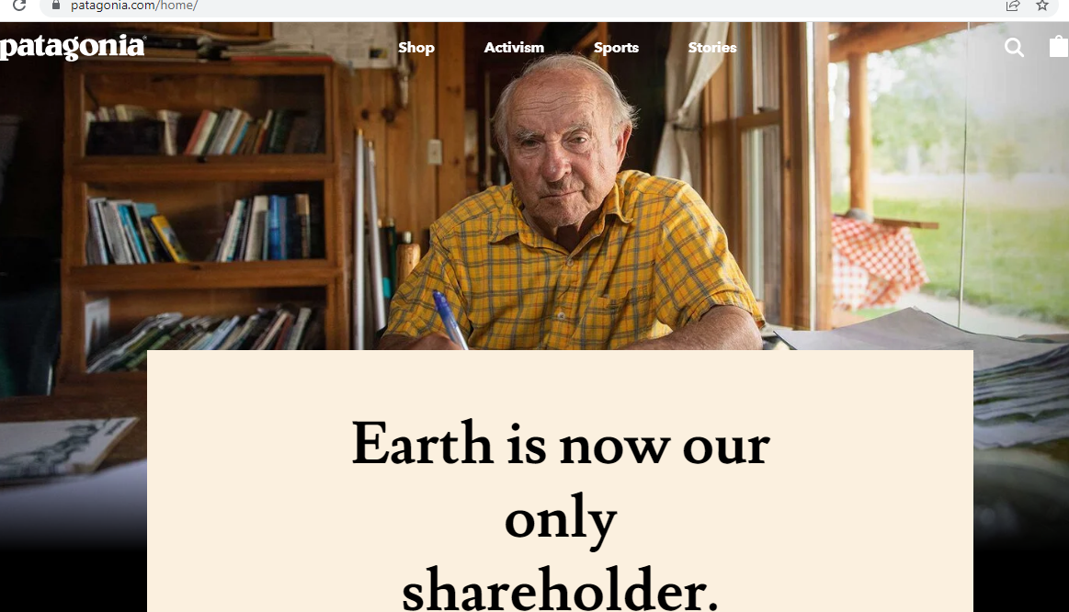
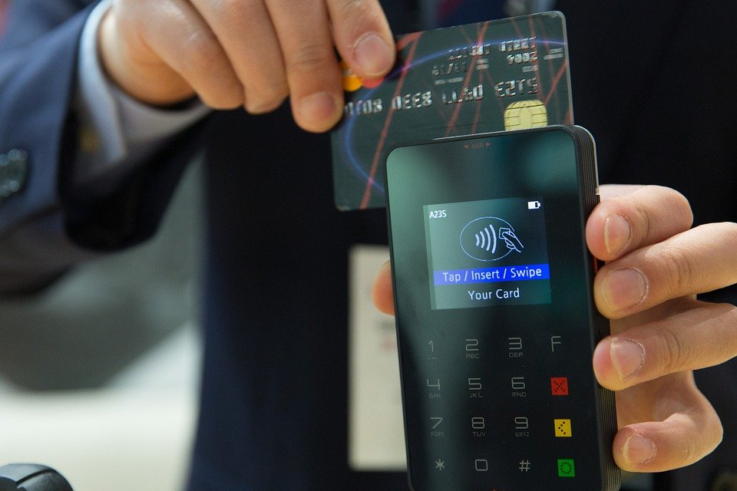
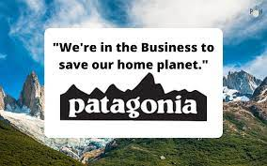
Benefit the Organization
Notes:
https://pixabay.com/photos/credit-card-payment-credit-card-1730085/

Slide 26
“An organizational function and a set of processes for creating, communicating and delivering value to customers and for managing customer relationships in ways that benefit the organization and its stakeholders…”
Source – A Framework for Marketing Management by Philip Kotler & Kevin Keller

Slide 27
An Analysis
Creating Value
Communicating Value
Delivering Value
Benefit
Industry
Detergent for Whites
Ads, Promotions
Super Markets
Kirana
Wholesalers
Amazon
Big Basket
Owned Website
Profit
Stakeholder/Ecosystem Profitability
Sustainability
Tide
Content for Entertainment
Outdoors
Social media
On APP
Owned APP
Owned Website
Profit
Stakeholder/Ecosystem Profitability
Netflix
Harvard
Alumni,
Ads,
PR
Campus
Coursera
Events
Enterprise Solution
Profit
Stakeholder/Ecosystem Profitability
MBA for Growth
LIC
Insurance for Security
Ads,
PR,
Direct Selling
Owned Branches
Franchise
Brokers/Mid Men
Banks
Profit

Slide 28
An Analysis
Creating Value
Communicating Value
Delivering Value
Benefit
Industry
Facebook Seller
Connection
News
Content
Ads
WOM
Algorithm/APP
Website
APP
Users
Time Spent
Facebook Buyer
Targeted Reach
Panels
Seminars
Direct Selling
Ad Manager
Special teams
Profit
Stakeholder/Ecosystem Profitability
DLF Mall Seller
Shopping experience
Ads
Festivals
Sales
Destination Stores
On Premise
Footfalls
Bills Cut
DFL Mall Buyer
Targeted Reach
Direct Selling
PR
Stores
Profit
Stakeholder/Ecosystem Profitability

Slide 29
An Analysis
Creating Value
Communicating Value
Delivering Value
Benefit
Industry
Funds
Support
Self help Groups
Volunteers
Self Help Groups
Volunteers
Funds
No of Children Supported
CRY - Seller
CRY -Buyer
Targeted Philanthropy
Ads Medis
Direct Mailers
Enterprise Teams
Website
Mailers
Stakeholder/Ecosystem Benefits
Pixis
(Mar Tech)
AI tool to Drive Performance Ads
Direct selling
PR
Linked in
Events
Pod cast
Newsletters
Website
Teams
Self Managed Tools
Profit

Slide 30

Exercise 1 – Work in Groups, Present in next class
Build this for Microsoft, Nike, Red Cross, Mesa, Uber

Slide 31
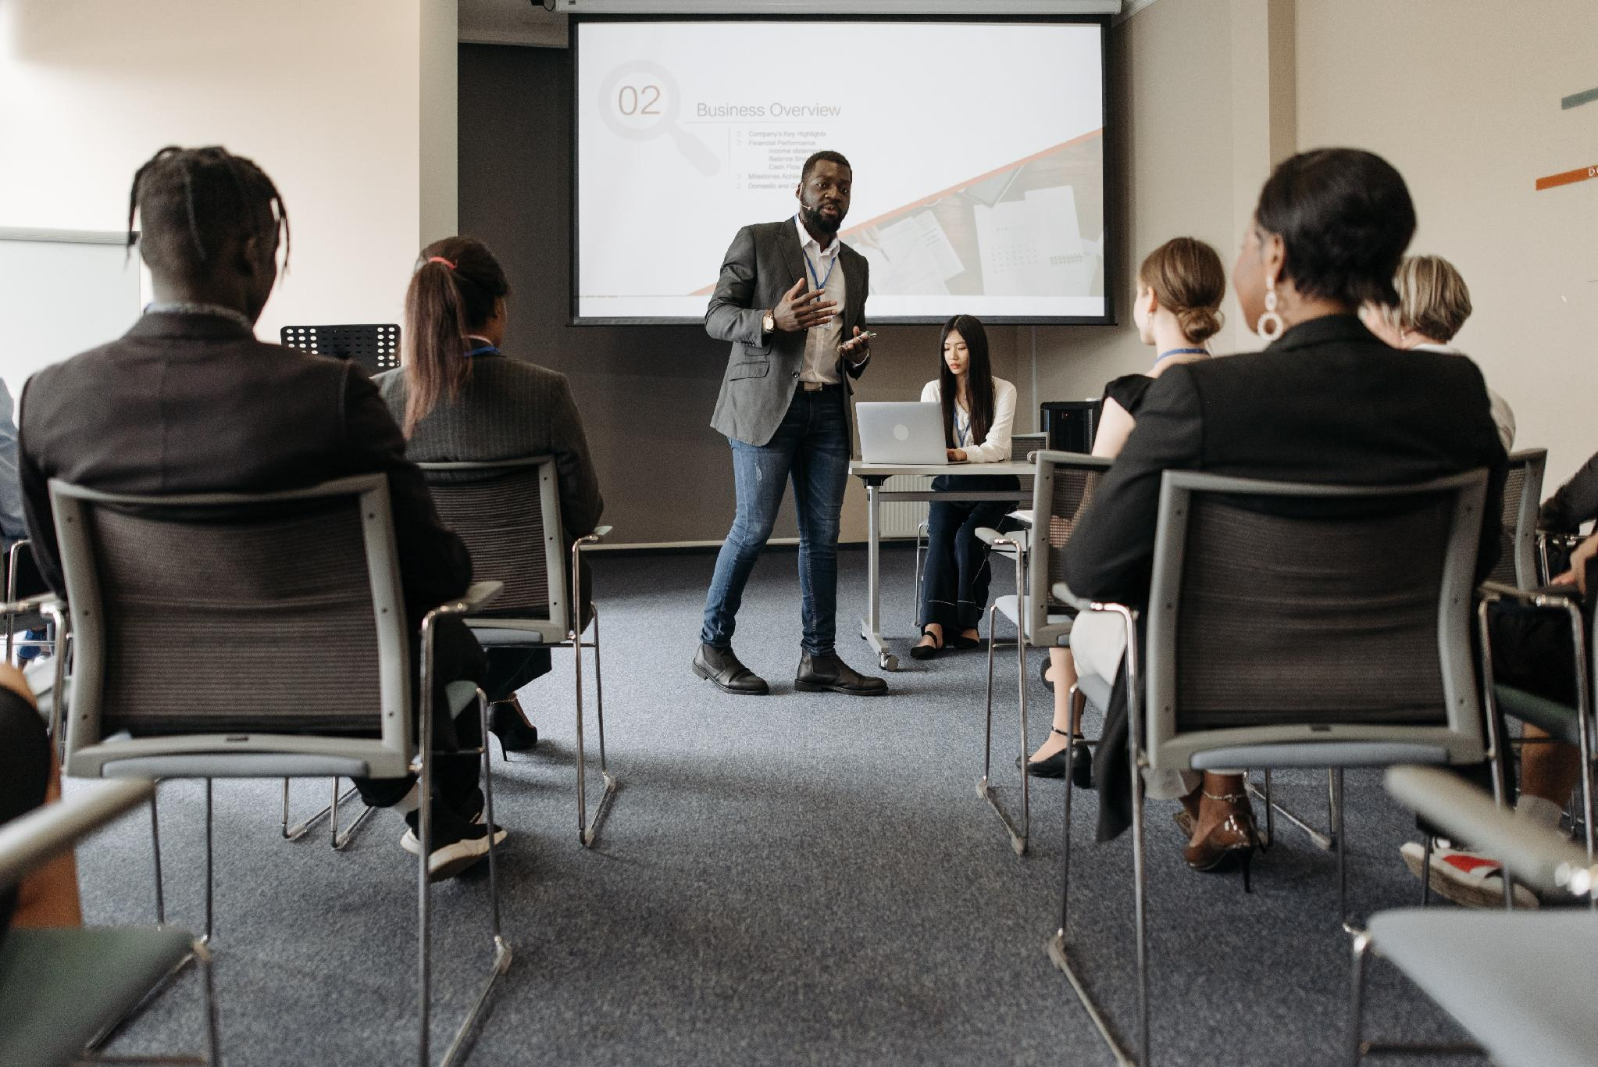

the Course
Session 1
Grounding -
What is marketing
The Course
Session 2
Critical Concepts
Needs, wants, Demands
Consumer vs Customer
Marketing Environment
Session 3
Consumer Behavior
Neuroscience
Consumer Buying Behavior – Consumer Bias
Consumer Funnels
Session 4
Target Consumer
Segmenting & Targeting
Pen Profiles
Understanding Motivations
Session 5
Customer value
Types of Benefits
Differentiation
Positioning

Slide 32
the Course
Session 7
Go to Market 1
Elements of GTM
Anchor vs user TG
Session 8
Go to market 2
Channel & Retail Environment
Platforms
Session 9
Drive Growth & Measuring Success
PITA
Marketing Objectives
Brand Health
Session 10
Measuring Success
Business health
Digital Funnel & Measurements

Slide 33
Prep For Next Session
Read about the consumers( in the slides below)
Notes:
USEFUL VIDEO – Steve job Launch of the Apple I phone- https://www.youtube.com/watch?v=MnrJzXM7a6o
Good movie to Watch – Blackberry

Slide 34



Session 2 Pre-Reads
Profiling Aditya ( Adi) – Slide 3 -10
Profiling Shani Ram ( Slide 11 onwards)

Slide 35
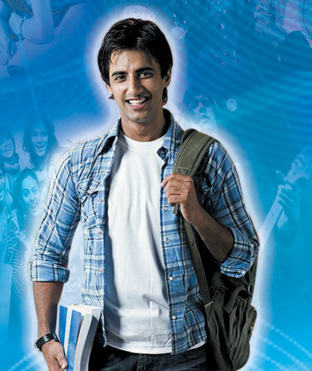
Hi….I Am Aaditya
Most of my friends call me Adi….I am 21 and currently live in Bangalore city. I have got only a few minutes to chat…..meeting my friend Arhaan in about half an hour or so….we are going to check out the New Harley store that has just opened.
I am in my last year of Commerce…..
I have been taking photography lessons over the last one year and I plan to join one of my cousins as a intern in his publications. My real passion remains photography.
I plan to do a some free lance work over the weekends that will give me some experience and will help me build a portfolio. Hope to work for National Geographic one day and travel the world with them.

Slide 36
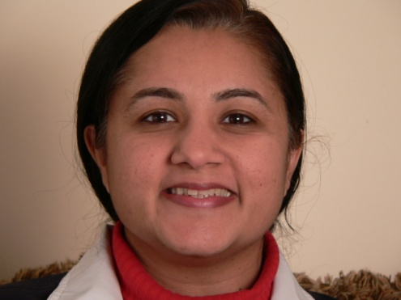

My Family
My dad is a doc…has his own thing @koramangala….that is him in the photo….before you say anything….I look like my mom!
Ma is teaching at the school nearby. She is the best……protects me from Dad….Just Kidding!….and makes the most outstanding chicken ever!
We live in two and a half bedroom flat and I have a half to myself!!!
My parents are supportive of my passion to do photography……. But like any of the other folks….they seem a little bit paranoid. They have also advised that I sit for MBA entrance exams as a back up…..am not too sure of that…..would rather not.
Oh….i forgot to tell, apart from the publication thingy…….I also have an offer to join a gaming company…..that seems like fun!

Slide 37
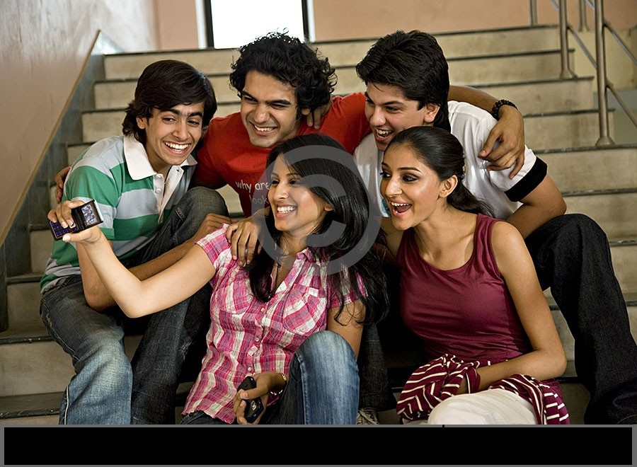
The Gang
I have these great bunch of friends with whom I have developed a close relationship over the last 3 years of college. Here is a cool snap of some of them I took yesterday.
We are known as a pretty easy going and chilled out lot…… We hang out everyday after college…catch a movie…a cup of coffee….drive around. There are days, when just the guys catch up for a drink at Pecos or Purple Haze.
The guys, Arhaan, Prateik, Jared & Rohit are the best…..i trust them with my life. With these guys, I can be rest assured that life will always be truck loads of fun

Slide 38
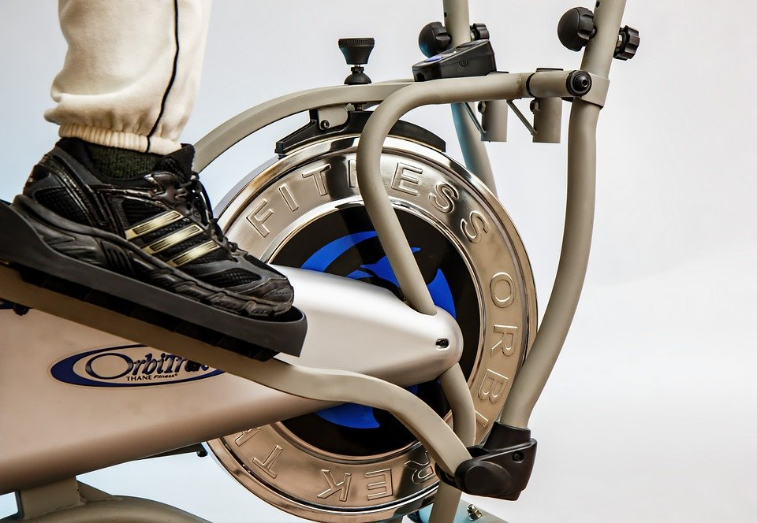

How I Spend My Days
Stop by the gym before I get home.
Once I am home.....catch up on a bit of TV….chat on the phone….sync songs on the ipod……browse the net…facebook ( but that I am on through the day thanks to my phone)…and before you know it…the day is over.
Oh Yes….sometimes gotta’ do some college assignments also which keep me up at night…..unless I just get a copy of the assignment from someone else.
Mom often complains that I don’t tell her about what is happening in my life……she claims all that she knows is what she sees on facebook!!..... Little does she know that I have given her restricted access only……..I think I will give her full access soon.

Slide 39

My Love Life….
As far as relationships are concerned, just got over one……..Her name is Jennifer…...We went out for over 9 months…..unfortunately….did not work out. She claimed that I did not give her enough time……hmm……. The guys think its for the best and don’t think the demanding type is good for me. They also said I was a very different person when she was around!
But now……… there is this girl Neha who joined the group last year. Very pretty…. smart, funny and outgoing. Been trying to spend a lot of time with her.
Joined drama classes in college to be with her. I thought the sessions will be crap, but it is not too bad at all.
Also, I think this time with her worked…..think she is beginning to like me….….will ask her out soon….
The good thing is….mom seems to like her too….whenever the gang come home…you can see the both of them chatting away.

Slide 40
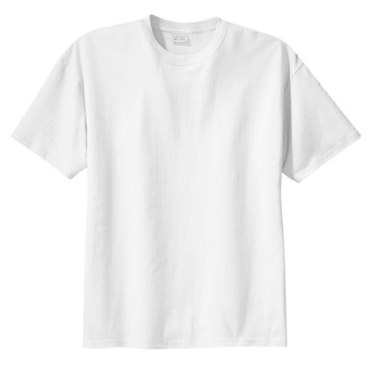
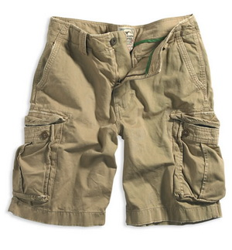


My Style……
I like to keep it simple…..with my tee and jeans or cargos….Tried out linens the other day….its pretty cool!
I shop around for brands…..and this other boutiques that sell seconds from brands like Gap, Banana Replublic & Aeropostale
I keep updating my wardrobe….but have my favorites that I will never get rid off. We have been through a lot together….like this one I am wearing right now was what I wore when we decided on the spot to drive to Chennai….. another story another day.
Got a massive collection of watches & belts…love them

Slide 41
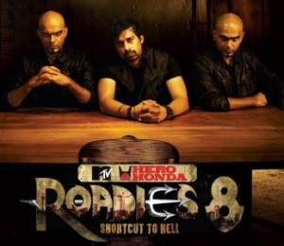



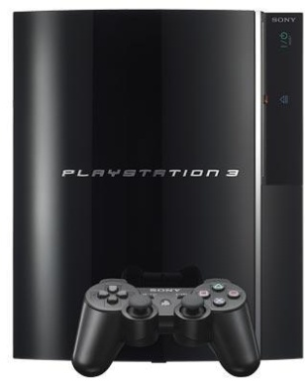
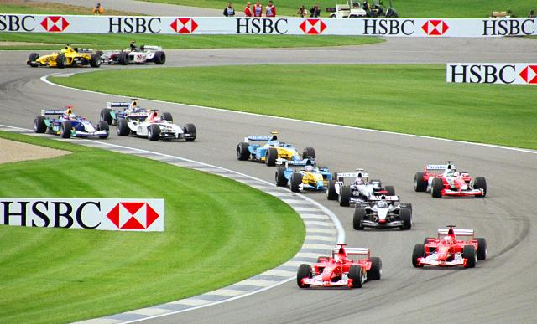
My Entertainment
Love to watch movies….both Hindi & English. The current lot of Hindi movies are fantastic…unique and good story telling. On TV, I catch all the sports like football, cricket, basketball and formula one. I manage to sneak in a movie sometimes on one of the evenings. Also watch a lot of reality shows….some very good ones on air currently.
Just upgraded to an PS3…..looking forward to the new games that I plan to buy. Listen to a lot of music on my iPod……trying to convince Dad to give me an iPad this year for my birthday….otherwise will pick it up with my first salary in a few months from now.
Over the weekend, catch up with the guys to watch EPL and Formula One race. Love travelling…… just recently camped out at Nagarhole National Park with the gang….got some great photos. Love to drive …..especially my friend’s SUV. Looking forward to buying my first car soon.

Slide 42
What I Want From Life
Gosh….that’s a tough one….. Where do I start……want money….…..but don’t want to tread the MBA path….would love to do it through the lens…..
Want my own pad……design the interiors myself…would love the first car to be an SUV…lets see!
Want Neha for now…..Want to take my friends wherever I go……don’t want to lose them after I leave college….want us to do the same things tomorrow what we do today. People say as we get older and get more responsible…..life will become duller…….damn!!!!!.... would hate for that to happen. With the guys, I doubt that will. In fact, we have made a pact that no matter where we are…..we will meet once a year and do road trips!!!
Speaking of road trips…..Want to travel…..the world is a big juicy invitation that screams “try me”…and that’s exactly what I am going to do…..I am up for Anything….bring it on.....My parents to be healthy and happy! Gosh …look at the time….got to go….will send you guys a Facebook invite…..will try and catch up on WhatsApp also.

Slide 43
Session 3 Pre-Reads
Profiling Aditya ( Adi) – Slide 3 -10
Profiling Shani Ram ( Slide 11 onwards)

Slide 44
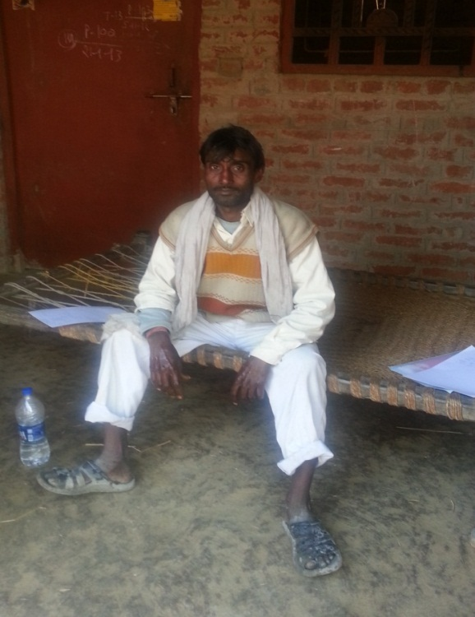
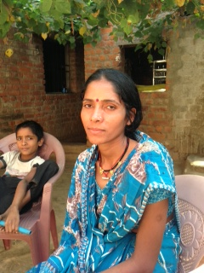
Meet Shaniram & family
Shaniram, age 35, is small farmer in Samesi village in UP.
His family consist of his wife Saraswati Devi and children – Bhagmati(10), Ramesh (7) and Rahul (3)
Shani’s parents passed away and his siblings have moved out of their home.
His brother sold his inheritance and opened a retail store in Hasanpur village, which is 15 km away
His elder sister, Shakuntala, got married and is now staying in Lucknow.
Saraswati is from Mauranva village (50 km away) and moved to Samesi 12 years back when they got married.

Slide 45
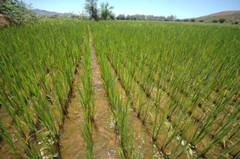
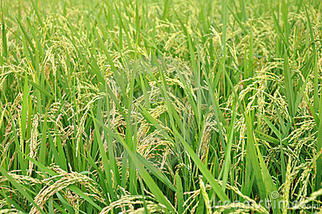
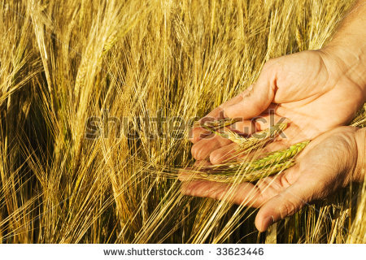
Shani’s Two hectare dream!
Shaniram inherited two hectares of land from his father.
His father used to plant only rice in July and harvest the same in Oct/Nov. Sometimes, he used to grow wheat in the rabi season. This was only done during emergencies or crop failure of the previous harvest
But Shani came to hear from other farmers and the pradhan on how he can crop the land more than once on a periodical basis.
For the last 2 years, he has been harvesting rice in Nov and wheat in March.
Before that, he used to work in other people’s farm from Nov to March.
Now, with wheat produce, he has doubled his income. Also, this helps him to store extra (rice and wheat) for contingencies.
Notes:
1 hectare = 10000 sg meter, 2.5 acres

Slide 46
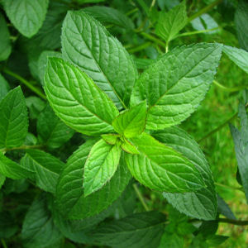

Shani’s Two hectare dream!
In addition to wheat and Rice, Shani wants to add another crop between March and July
He has got information from the Mandi that he can grow peppermint. He is unsure on how to go about it and is worried about the impact it will have on the land.
Also, he has decided to buy a tractor…..
While his land does not require the full time use of a tractor, he believes he can generate additional income through the tractor by hiring it out to other farmers or use it for commercial haulage.

Slide 47
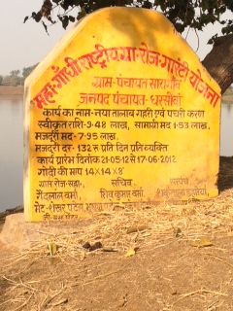
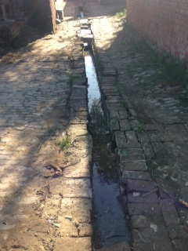
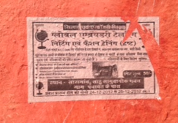
Saraswati also brings in money into the household
She is also an active income earner. She has been working over the last 2 years.
She seeks employment through NREGA. Last year, she did around 30 days of work earning Rs 120/ day.
She was involved in the creating a drainage outlet around the village, which she believes has helped in clearing the all the dirt around the village.
She is happy with the Anganwadi center that was established in this village 4 years back. She can now go to work keeping Rahul (3) under the able care of the Anganwadi worker.
She is also thinking of pursuing knitting classes which she believes will give her additional income that they can save up for the children

Slide 48
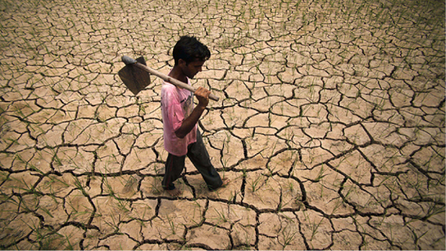

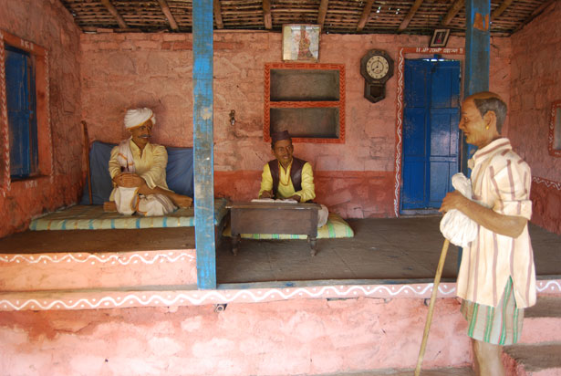
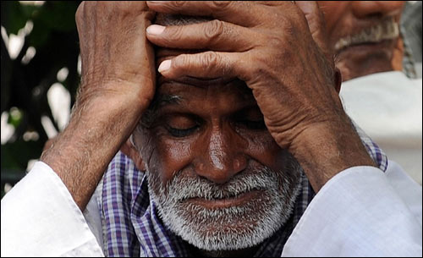
A lot has changed in the village… Things were very different in the past…
Shani reminisces that in past there were very limited resources available to them….
Money was hard to come by…..and there were times when they had little ability to spend.
He remembers those days of drought or crop failure which really stretched the family resources and savings.
Or when his sister was married and his father had to borrow from the local money lender for the marriage celebration. For the next few years, the whole family had to stretch to pay off the loan.

Slide 49
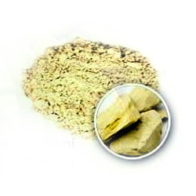
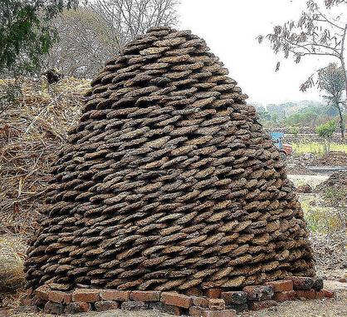
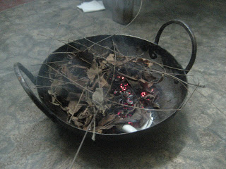
They had to use resources that were readily available
“ We did not use soap… we used Multani Mitti to bathe or clean our hair”
“My grandparents prescribed cow dung for Medicinal purposes”
“We used to use salt & lemon to wash our dishes”
“ We used to use Neem to get rid of mosquitoes”

Slide 50
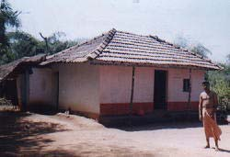

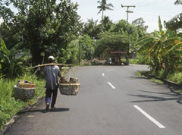
Over the last few years….the basics are now in place
Shani ‘s father dreamt of building a pucca house…but never had the resources to do so.
2 years back, Shani, with the support of the pradhan and the sarkar built his house.
Electricity is no longer an issue.
There is a water pump available in the village and one does not need to travel very far for the same. There is abundant supply of water.
With road network improving, Shani can travel to the nearby town Mandi to get a better price for this produce.
He is also in touch with the multiple middlemen through the phone to confirm the prevailing prices for crop produce.

Slide 51
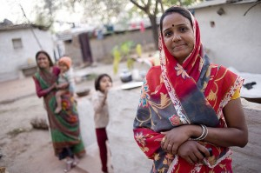
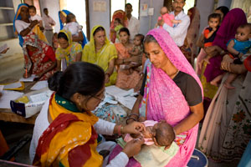

Strong influencers in the village also
They now actively approach the ASHA didi and Anganwadi worker for nutritional aspects of their child.
When Shani built his house through government support, he was advised by the local community to make a toilet.
Shani and Saraswati visit the nearby Primary Health center for health related issue. While the PHC has been around for the last 5 years, they first went to PHC only last year after a referral from the ASHA didi.
Bhagmati has also learnt a set of good practices from school which she tries to get the family to do and practice.

Slide 52




Shani and family have started adopting new categories and brands
With improved connectivity with nearby town, Shani and family have access to new products that have replaced some traditional methods.
Now, they use soap which has replaced multani mitti. They have started using shampoo since soap can cause hair fall.
Saraswati started using fairness cream 3 years back. She is also getting bhagmati to use the same.
They moved to detergents to wash clothes only in the last 4 years of so.
In fact, this winter they used a liquid detergent for their winter wear for the first time. Shani’s sister from Lucknow recommended this when she visited them in October last year. This gives an added fragrance and keeps the material soft.
A lot of these kind of new products needed to be bought from the nearby town….. but now the village has Kishoreji who has opened a new store which has all the products that you get in the town. They do not need to go very far to get something.

Slide 53

But some things just don’t change….
Saraswati still uses cow dung to clean the house once in while.
They still burn neem leaves to drive out mosquitoes.
They still cook with a old style choolah.
Shani & Saraswati have discussed about buying new modern day cooking equipment, but Shani has rejected the recommendation.
He does not see benefit in investing in the new equipment.

Slide 54



What does the future hold
Shani wants to increase his farm size in the years to come, but does not know where he is going to get the money from
He has to make the roof of his house pucca. Currently it is Kutcha
Both Shani & Saraswati are very keen that Bhagmati gets married to someone from their own caste. They have identified two prospects from nearby village. They have already started saving up for the marriage, but not sure it will be enough.
Their children have been pestering them to buy a TV for the house. Shani has looked around, but not bought the same yet.

Slide 55



Believe that education is a gateway to success
Shani & Saraswati did not go to school in their childhood. However, they believe that their children must be more educated
They initially sent them to school just for the mid day meal.
However, they believe that education should be the priority and are now evaluating sending Bhagmati and Ramesh to a new private school that has opened up, where all other villagers are sending their children. There is an additional cost of Rs 200 ( Rs 100 per child) in fees….but they believe it will help
According to the villagers, the school has many more teachers and attendance of teachers is good.
They also excited about a Maha Vidyalay that has opened up in a nearby village which their children can eventually go to.
Shani believes that there is not much profit in Agriculture and his children must move out to the nearby town and get a job. However, he worries that urban life is hectic and lonely unlike the relaxed village life amidst the close community of the villagers

